Slide 1








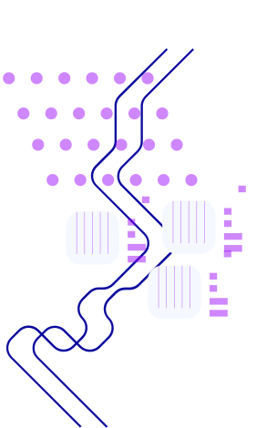



Educational Ham Radio Simulator
Facilitating CW communication learning, one dit and dah at a time
Team Heron: Yasmine El Mezouari, Mehdi Mamas, Lizzy Tubbs and Youssef Chekkori
Date: December 11th, 2024

Slide 2

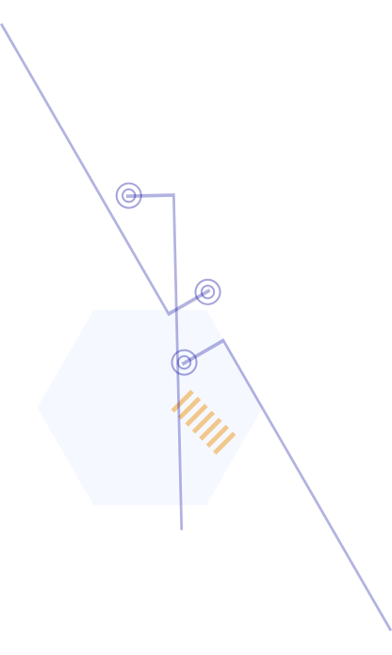
Table of contents
01
02
03
04
Intro
Features
Design Principles
Demo
05
06
07
08
UML Diagram
Teamwork
Insights
Acknowledgements
Questions

Slide 3
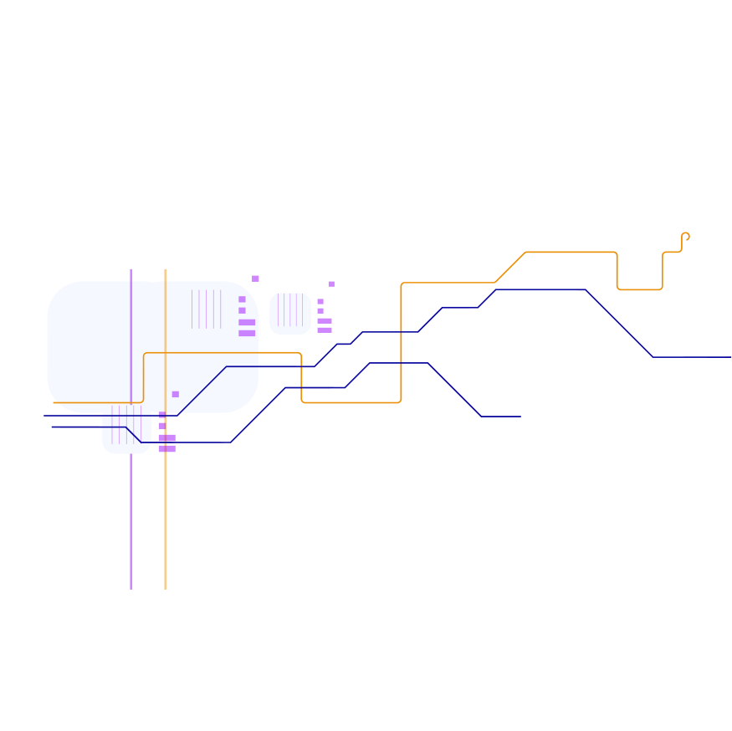







01
Intro

Slide 4






Context of our project
Target Audience
Goal
Beginners and hobbyist interested in amateur HAM radio transmission involving CW message communication.
Provide an engaging simulator that supports a smooth learning and practice of HAM communication skills, especially for very beginners.

Slide 5
Our Educational HAM Radio Simulator
Simple and intuitive software that facilitates HAM radio communication training with no equipment purchase necessary. Anyone can chose to start learning with no financial hassle.
No license required to start, only motivation!
Besides allowing realistic HAM radio communication. Our software also proposes personalized training to support CW learning across multiple levels.

Slide 6
02
Key Features

Slide 7
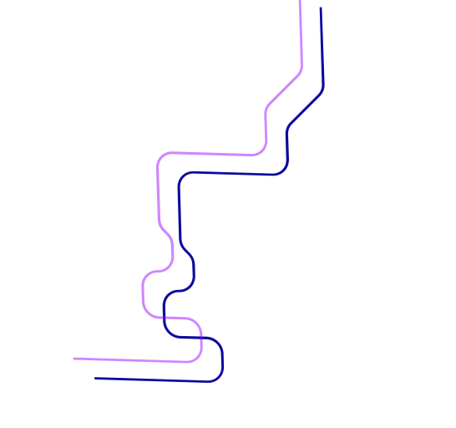

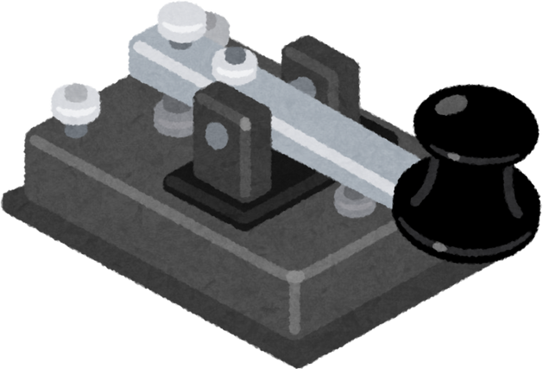

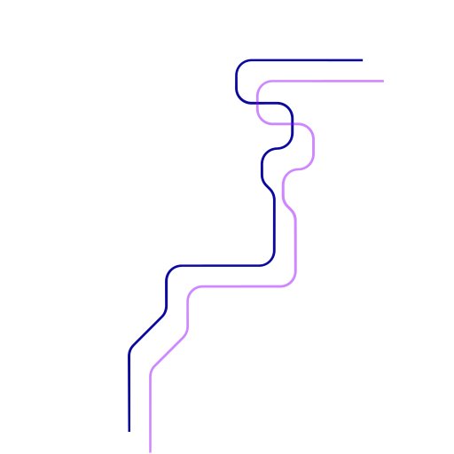


What we bring to the table
Live HAM Radio
Practice CW
Quick CW transmission and peer-to-peer communication with other users from different computers
Users can access the translation of the message they entered
Morse code input (straight key/paddle simulation).
CW can be practiced at different levels with our software
User can choose to either translate english to CW or listen to message and type it in CW
Softwares gives feedback (Correct or false) to user
Control speed of practice CW audio
Users can create, save and open “Scenarios” to play that are entirely customizable.
User can choose to add AI Bots that operate on specific frequencies just like actual humans would and “send” messages relating to the scenario description.
Scenario Builder

Slide 8
03
Demo

Slide 9
Let’s show off our cool software!

Slide 10
04
Design Principles

Slide 11

Design Principles
Single Responsibility Principle
Each class is focused on it’s own specific responsibility
Dividing responsibility makes the codebase modular and easier to maintain
Examples
TonePlayer: manages sound playback
MorseTranslator: translates cw into text
MorseHandler: manages user input and state transitions

Slide 12
Design Principles
Open/Closed Principle
Extensible format
Easily add new callbacks
Expand cw dictionary without altering core logic
Upgrade software without requiring major changes to existing code

Slide 13
05
UML Diagram

Slide 14
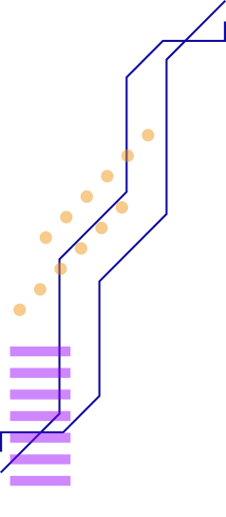
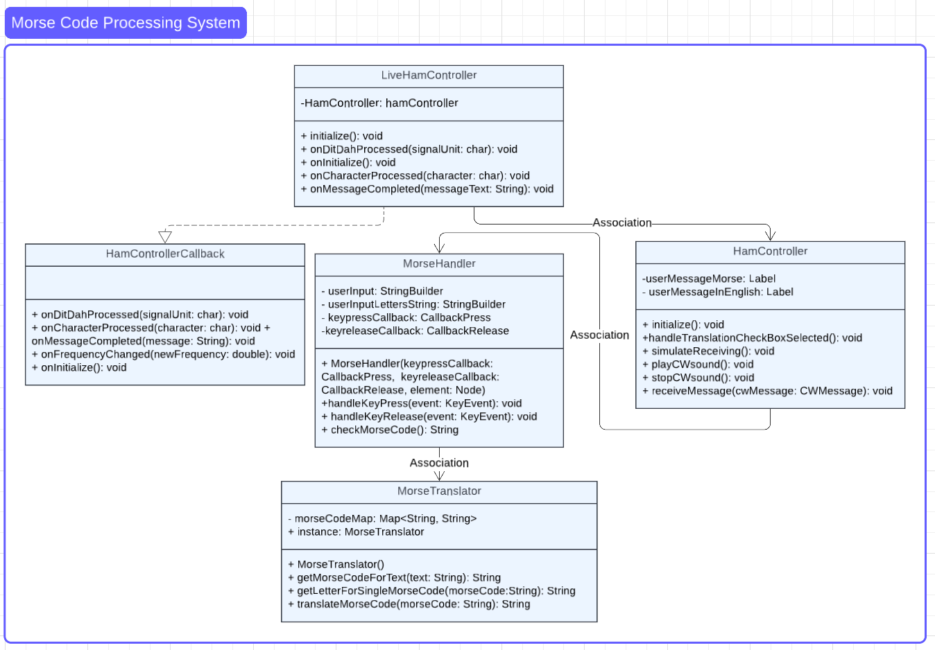



UML Diagram

Slide 15
06
Teamwork
Insights

Slide 16
Collaboration: distributed work load is always more manageable than individual work.
Communication and visualization: everyone understands concepts differently, so communicating about how to move forward prevents confusion when deadlines approach.
Agile development: having a working version of a software to expand and develop is better than waiting to release a perfect version.
Push frequently!

Slide 17
07
Acknowledgements

Slide 18
08
Conclusion

Slide 19



Concluding and Q&A session
User Engagement
No equipment necessary
Our simulator allows beginners to practice HAM radio skills effectively
Get started and improve with no complicated hardware
CW Proficiency
Scenario Building
Tailored to provide CW learning and improving
Users can create and completely customize a “scenario” to play using AI bots.

Slide 20
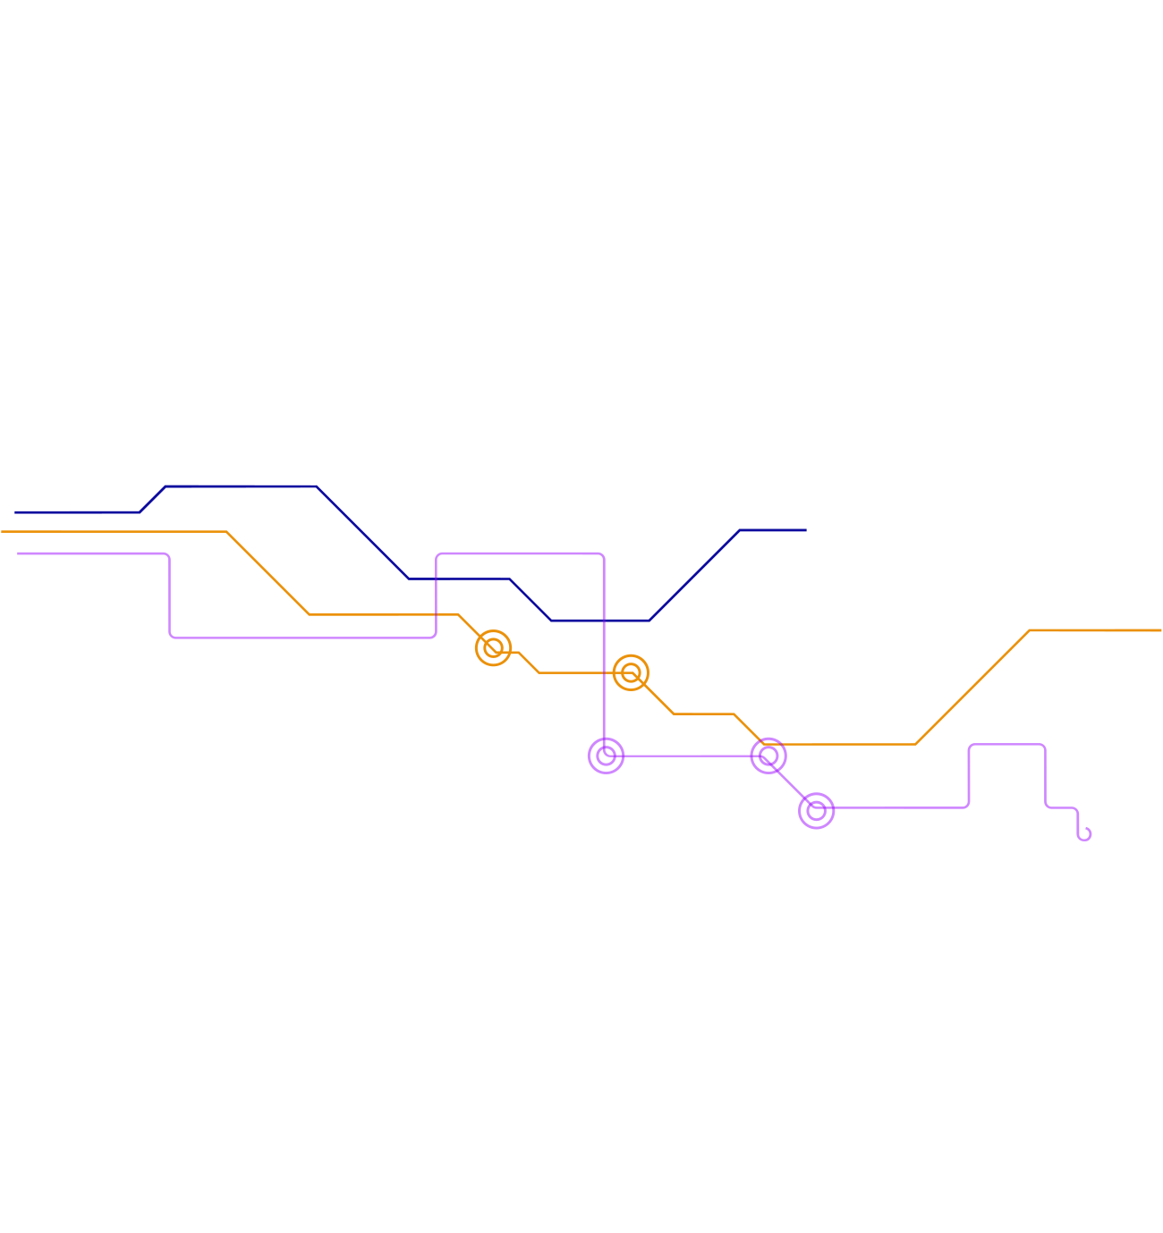
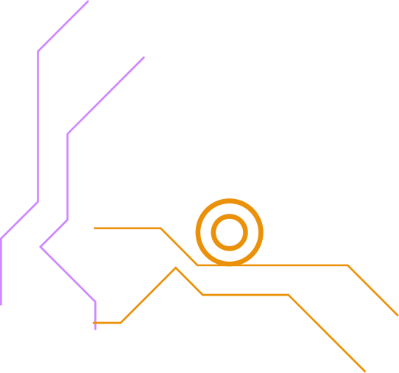

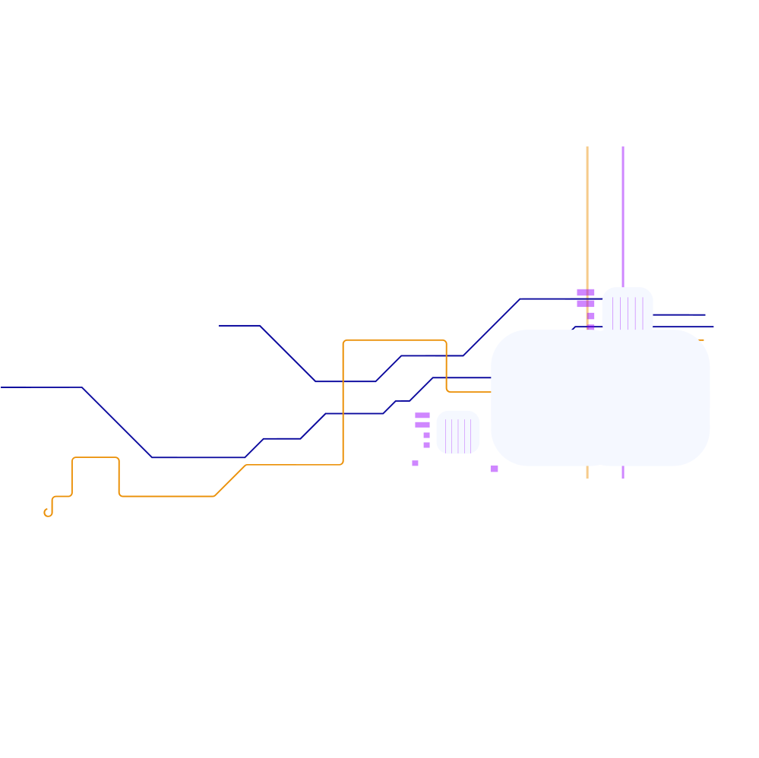

Thank you to everyone for their attention, special thanks to all the collaborators, Dr. Stonedahl and Dr. Vincent for the help on this project

